Slide 1
Precision Technology

Slide 2
WHY TEST AT HIGH SPEED?

Slide 3
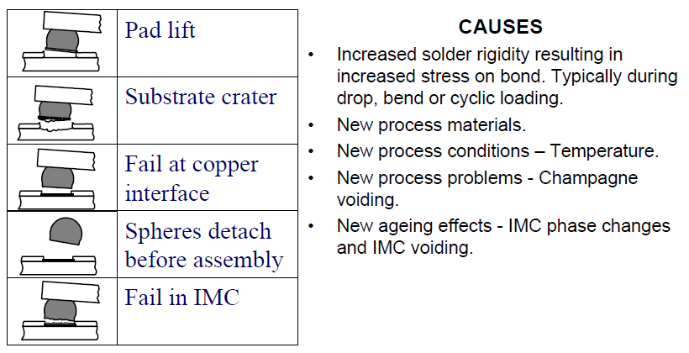
Typical manufacturing and end use failures

Slide 4
A Bond Tester is normally required to test the bond
Virtually all low speed tests result in solder shear.
Therefore strength information about the bond is limited by the solder shear force.

Slide 5
Typical high speed failures
IMC (Bond) Failure
Pad Crater

Slide 6
Also material properties are dependant on the rate of strain and many manufacturing and end use load conditions that are the cause of failure are high strain rate events – “Mechanical Shock”

Slide 7
High speed testing produces the same failure modes as seen in manufacture and end use

Slide 8
High speed testing
Vs
Board Level Drop Testing

Slide 9
Board level drop testing
  Costs 10’s k$US
  Takes months of preparation
  Is difficult with possibility of large errors and distributions
High speed impact testing
  Very low cost $’s/test
  Real time results

Slide 10
It has been shown in the literature that high speed testing correlates with the resilience of a solder ball interconnect to mechanical shock
It has also been shown that energy is a better metric than force (Force being a more traditional metric for electrical bond strength but energy being used extensively in many industries for mechanical shock)

Slide 11
Typical test vehicles for such studies relied on the known and different relationships between ENIG and OSP to thermal aging.
High speed testing using energy has been demonstrated to differentiate and correlate with the known trends that,
With no aging OSP is stronger than ENIG
With aging the strength (energy) of OSP reduces more rapidly than ENIG and can become weaker.

Slide 12
Put simply,
A bond that can absorb more energy in a high speed test will have better performance to mechanical shock.
This may be considered an obvious expectation

Slide 13
The industry adopted low speed force as the metric without any qualification but continues to debated high speed and energy at length whilst still using force!
High speed testing is beyond reasonable doubt a better method than traditional low speed

Slide 14
Understanding the Force (FvD) Displacement Graph

Slide 15
The FvD graph “Describes” the strength of the bond and the type of failure mode

Slide 16
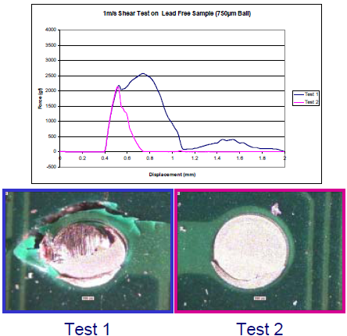
Simple failure mode = Simple FvD

Slide 17
Complex failure mode = Complex FvD

Slide 18
Bond failure starts here
Shape before failure which is the elastic and plastic deformation of the solder ball is the similar
Shape after failure is characteristic of the failure mode and different

Slide 19
Slope here is the stiffness
Area under the graphs is the energy

Slide 20
The energy here of this pad crater occurred after the failure and is not an indication of strength since the bond had failed before this energy was absorbed.
The large post failure energy resulted from mechanical locking between the lifted material and the substrate

Slide 21
Energy before the failure peak is the strength before failure
Energy after the failure peak is characteristic of failure mode

Slide 22
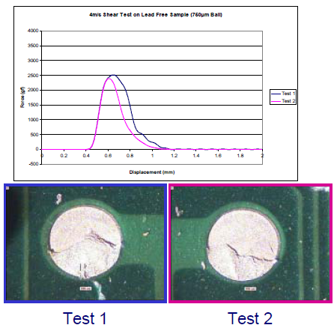
Brittle fracture is less strong and can absorb less energy - “shock”
More brittle fracture =
Less energy

Slide 23
How to Test at High Speed

Slide 24
Very similar to traditional low speed
Shear using energy as the measurement of strength

Slide 25
What speed do you test at?
The sample should be tested at the “transition speed”
This is the speed at which ductile (solder shear failures) and the failure mode of interest (brittle fracture or pad crater) occur in approximately equal amounts

Slide 26
At the transition speed the test is most sensitive to changes in strength of the failure mode of interest.
If you test at a too low speed you get all ductile failures
If you test at a too high speed you get all brittle or pad crater failures

Slide 27
If you test at the transition speed you get nominally equal amounts of each failure.
If the measured bonds get stronger a corresponding shift will be seen in the failure mode and energy

Slide 28
If you are investigating brittle fractures you can use the total energy
If you are investigating pad craters you may have to use energy before peak since the energy after peak is subject to additional post failure mechanisms

Slide 29

In reality you get mixed mode failures so the transition speed is calculated from the percentage of each failure mode in each test. Example,
50% brittle
50% ductile
25% brittle
75% ductile
75% brittle
25% ductile

Slide 30
Do not mix the data between different failure modes
Even if they occur on the same sample analyse the brittle a pad crater data separately

Slide 31
Find the transition speed by testing at different speeds
Do a few tests to get a feel for the speed relationship
Then home in around the transition speed taking about 10 tests at about 4 speeds where the transition seems to be
Chose the speed closest

Slide 32
If the transition speed is above the maximum speed possible test at the maximum speed

Slide 33
Collect data for the samples of interest
The samples with the highest energy values will have the best resistance to mechanical shock

Slide 34
What energy is acceptable?

Slide 35
No industrial standards exist
This is because of the large variance in constructions – Different solder alloys, surface finishes, substrates, NSMD vs SMD, process conditions and geometries
Industrial standards will only be possible when and if some construction standardisation occurs

Slide 36
Until industrial standards are available you will have to derive your own energy control limits based on initial energy measurements and the knowledge you have of the product

Slide 37
If the product is not performing monitoring high speed energy will enable you to determine if design or process changes are likely to result in an improvement
If the product is performing monitoring high speed energy can provide a quick, low cost and real time quality metric

